Slide 1

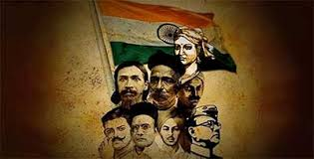
Tribal Hero of India
EIILM KOLKATA
BY
MANAS MONDAL

Slide 2
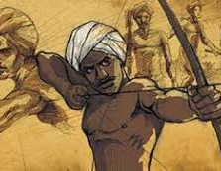
BIESA MUNDA
Introduction
Leadership
Ulgulan Movement
Objectives
Capture and Death

Slide 3
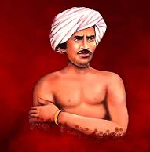
INTRODUCTION
Birsa Munda was a freedom fighter, religious leader, and folk hero who belonged to the Munda tribe .Birsa Munda was bron on 15 November 1875 at Jharkhand . His father name Sunga Munda and mother name Karmi Munda.

Slide 4
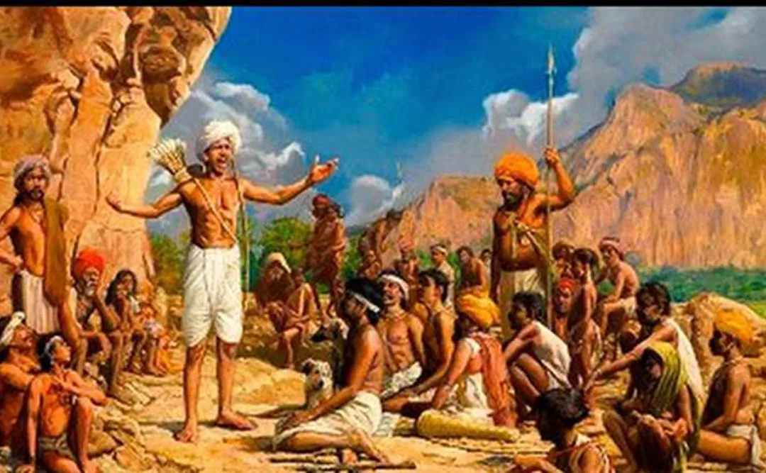
Leadership of Birsa Munda
Birsa Munda emerged as a leader among the Munda, advocating for their rights and rallying against the injustices they faced.

Slide 5
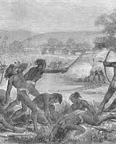
Ulgulan Movement
Birsa initiated the Ulgulan movement in 1899 to challenge British oppression. It aimed to reclaim tribal lands and assert the rights of indigenous communities facing exploitation.

Slide 6
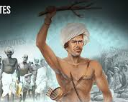
Objectives
he Ulgulan movement sought to confront unjust colonial policies and reclaim tribal lands seized by British authorities and local landlords. Birsa Munda's leadership provided a focal point for these objectives.

Slide 7
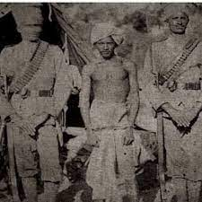
Capture and Death
Despite the resistance, Birsa Munda was captured by the British in 1900. He died under mysterious circumstances in prison on June 9, 1900, at the age of 25.

Slide 8
Thank you

